Slide 1
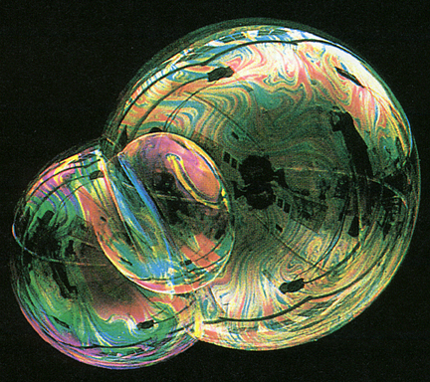
Interference of Light

Slide 2
Interference of waves
Coherent waves must have a constant phase difference.
This means they must have the same frequency. Often the phase difference is zero but it doesn't have to be.
Light is emitted by electron transitions within individual atoms. Thus waves from the same source will have the same frequency but will not be coherent as the phase difference will vary. (Except for laser light)
For coherence the wave must come from the same position on the light source – division of wavefront.
Or from the same wave which is split in two by reflection – division of amplitude

Slide 3
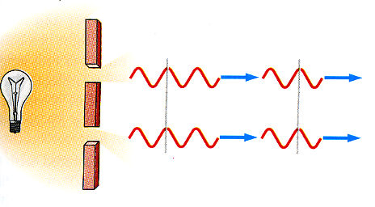
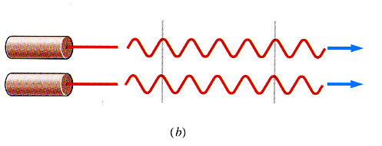
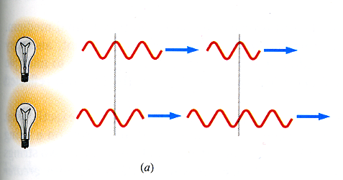
Interference
Coherence and Monochromatic
No coherence between two light bulbs
coherence - two or more waves that maintain a constant phase relation.
Coherence time
Coherence length
Some later time or distance
monochromatic - a wave that is composed of a single frequency. Heisenberg uncertainty relation.

Slide 4
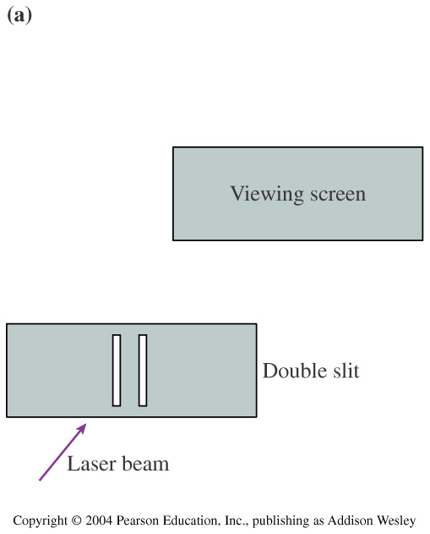
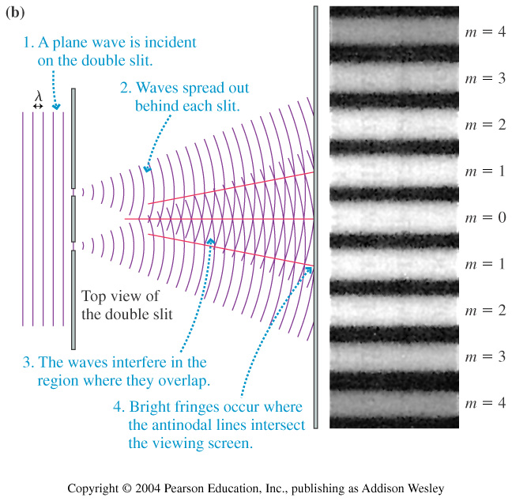
Interference

Slide 5
Conditions for Interference
If two waves have a definite phase relationship then they are coherent.
Otherwise, they are incoherent (ex: two light bulbs).
For Interference:
  The sources must be coherent.
  The sources should be monochromatic.

Slide 6
For Constructive Interference:
The waves must arrive to the point of study in phase.
So their path difference must be integral multiples of the wavelength:
ΔL= nλ
n=0,1,2,3,………

Slide 7
For destructive interference:
, the waves must arrive to the point of study out of phase.
So the path difference must be an odd multiple of λ/2:
ΔL= n λ m=1/2,3/2,5/2,….

Slide 8
For interference in air (vacuum)
Constructive path difference = n λ n = 0,1,2…
Destructive path difference = ( n + ½) λ
m
m
(m
For interference in another medium we have to use the optical path difference.
water
Optical path length is the distance for the same number of wavelengths in a vacuum

Slide 9
A
B
The two rays have different geometrical path lengths but have the same optical path length. Ie they contain the same number of wavelengths.
This means a lens does not affect the phase difference between rays

Slide 10
For destructive interference the path difference must be equal to an odd number of half wavelengths.
2nd + λ/2 = (m + ½ ) λ
2nd = mλ + λ/2 – λ/2
For destructive interference, m=1 for minimum thickness.

